Slide 1

Computer Communications
& Networks
CSNC-2413
Week: 6
Computer Networking: A Top Down Approach
6th edition
Jim Kurose, Keith Ross
Addison-Wesley
March 2012
Ch 3 : Transport Layer
Connectionless transport UDP
TCP Concurrent server
Dr Nauman Mazhar
Faculty of Information Technology (FIT)
University of Central Punjab (UCP)

Slide 2
Chapter 3: Transport Layer
Our Goals:
Understand principles behind Transport layer services:
  Multiplexing and demultiplexing
  Reliable data transfer
  Flow control
  Congestion control
Learn about Transport layer protocols in the Internet:
  UDP: connectionless transport
  TCP: connection-oriented transport
  TCP congestion control

Slide 3
Chapter 3 outline
3.1 Transport-layer services
3.2 Multiplexing and
demultiplexing
3.3 Connectionless
transport: UDP
3.4 Principles of reliable data
transfer
3.5 Connection-oriented
transport: TCP
  segment structure
  reliable data transfer
  flow control
  connection management
3.6 Principles of congestion
control
3.7 TCP congestion control

Slide 4





Transport layer services
Provides communication between appl processes running on different hosts - as if hosts connected directly
Transport layer may provide
following services…
  segmentation / re-assembly
  connection oriented / connection less
  multiplexing / de-multiplexing
  reliable, in order delivery
  flow & error control
  congestion control
  process-to-process comm,
  end-to-end transport
application
transport
network
data link
physical
network
data link
physical
network
data link
physical
network
data link
physical
logical end-end transport
network
data link
physical
network
data link
physical
application
transport
network
data link
physical

Slide 5
Segmentation & Reassembly
To exchange messages, transport layer performs segmentation &
re-assembly (if data size is more than the specified segment size)
  Send side
    breaks app messages into
    segments
    passes to network layer
  Recv side
    reassembles segments into messages
    passes to app layer
More than one Transport protocol
available to apps
  Internet: TCP & UDP
application
transport
network
data link
physical
network
data link
physical
network
data link
physical
network
data link
physical
logical end-end transport
network
data link
physical
network
data link
physical
application
transport
network
data link
physical

Slide 6
Transport protocols above IP
N/W layer provides “best effort” delivery service in Internet
  IP is unreliable; no guarantee of data delivery & order
Tpt layer provides services above N/W layer
UDP: unreliable…
  simple extension of “best-effort” IP
  mux/de-mux, & error checking
TCP: reliable…
  provides reliability over IP…???
  mux/de-mux, error checking
  connection setup
  flow/error control, in order delivery,
  congestion control
application
transport
network
data link
physical
network
data link
physical
network
data link
physical
network
data link
physical
logical end-end transport
network
data link
physical
network
data link
physical
application
transport
network
data link
physical

Slide 7
Chapter 3 outline
3.1 Transport-layer services
3.2 Multiplexing and
demultiplexing
3.3 Connectionless
transport: UDP
3.4 Principles of reliable data
transfer
3.5 Connection-oriented
transport: TCP
  segment structure
  reliable data transfer
  flow control
  connection management
3.6 Principles of congestion
control
3.7 TCP congestion control

Slide 8

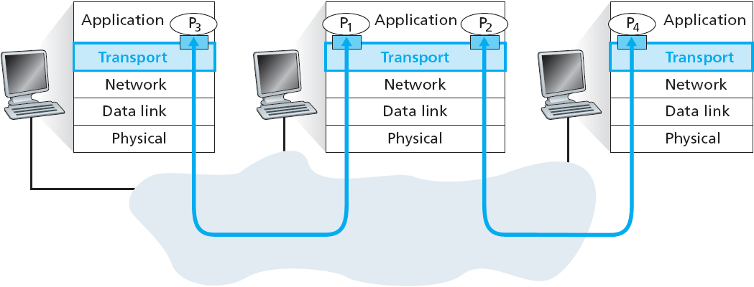
Multiplexing/demultiplexing
Demultiplexing at Recv host:
Multiplexing at Send host:
deliver received segments
to correct socket
gather data from multiple sockets, envelope data with header
& send to NW layer

Slide 9
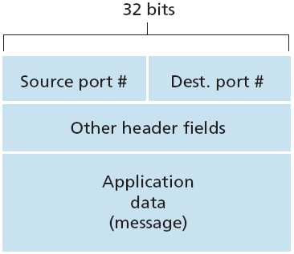
How demultiplexing works
Host receives IP datagrams…
  each datagram has source & destination IP address
  each segment has source & destination port number
  (recall well-known port numbers
  for specific applications)
Host uses IP address & port number to direct segment to appropriate socket
TCP/UDP segment format

Slide 10
Connectionless demultiplexing
UDP is connectionless
  implements connection less demultiplexing
Each UDP socket identified by its socket address:
( IP address, Port number )
  Server socket: user assigns
  well known port
  Client socket: kernel assigns ephemeral port
When host receives UDP segment…
  checks dest port number in segment
  directs UDP segment to socket with that port number
IP datagrams with different source IP & source port can
be given to same UDP socket
(this is how UDP server can serve multiple clients, using
same socket..!)

Slide 11
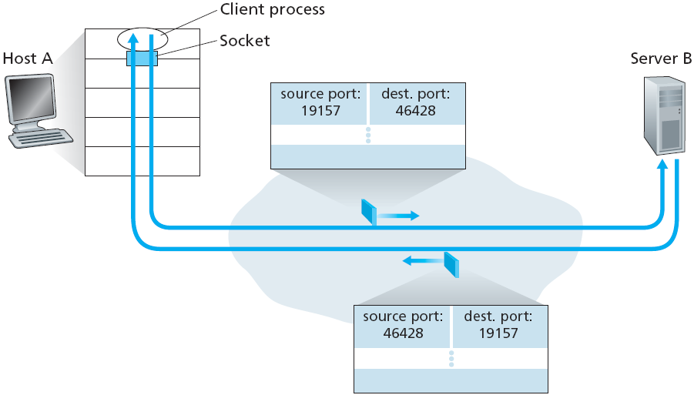
Connectionless demux
UDP socket based on IP address & port number

Slide 12
Connection-oriented demux
TCP implements connection oriented demultiplexing
TCP socket identified by
4-tuple:
  source IP address
  source port number
  dest IP address
  dest port number
Receiver uses all four values to direct the segment to appropriate TCP socket
TCP Server may have many simultaneous TCP sockets:
  listening & connected
  each socket connects to a different client
  each socket identified by its own 4-tuple
Web servers have a separate socket for each client
  non-persistent HTTP will have a different socket for each HTTP request

Slide 13
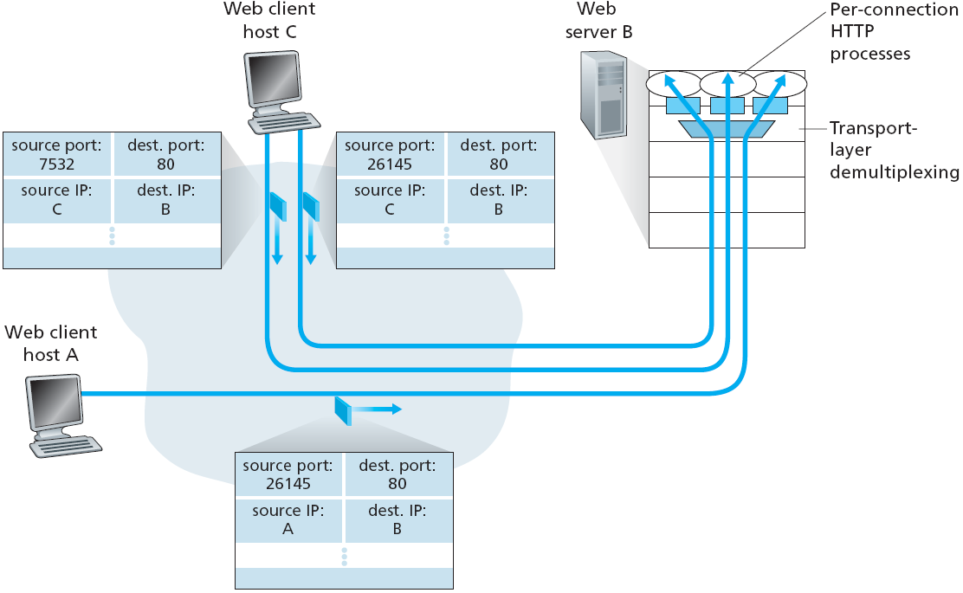
Connection-oriented demux

Slide 14
Chapter 3 outline
3.1 Transport-layer services
3.2 Multiplexing and
demultiplexing
3.3 Connectionless
transport: UDP
3.4 Principles of reliable data
transfer
3.5 Connection-oriented
transport: TCP
  segment structure
  reliable data transfer
  flow control
  connection management
3.6 Principles of congestion
control
3.7 TCP congestion control

Slide 15
UDP: User Datagram Protocol [RFC 768]
“no frills”, “bare bones” Internet transport protocol
Connectionless:
  no handshaking between UDP sender & receiver
  each UDP segment handled independently of others
“best effort” service,
UDP segments may be:
  lost
  delivered out of order
Why UDP is there ?
less overhead
small size packet header
low delay
no connection establishment
simple
no connection state at sender & receiver
finer appl level control
what data is sent, & when

Slide 16
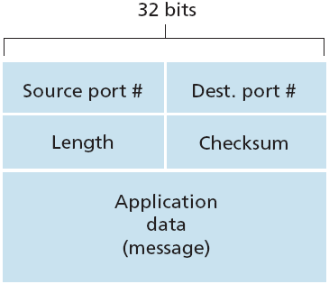
UDP: more
UDP Segment Structure
often used for streaming
multimedia apps
  loss tolerant, but rate sensitive
other UDP uses…
  DNS, SNMP
provides end-to-end error checking
  checksum
what if we need reliable transfer
over UDP…?
  add reliability at appl layer
  application-specific error recovery!
  (e.g, FTP based on UDP but with recovery)

Slide 17
UDP checksum
Goal: detect “errors” in transmitted segment (e.g, flipped bits)
Sender:
treat segment contents as sequence of 16-bit integers
checksum:
take 1’s complement sum of all 16-bit integers
then take 1’s complement of
the sum
put checksum value into UDP checksum field
Receiver:
recompute checksum of received segment
if computed checksum value matches received checksum
  YES : no error detected
  NO : error detected

Slide 18
Internet Checksum Example
Note
  1’s complement addition: when adding numbers, carryout from most significant bit is added to result
Example: add two 16-bit integers
1 1 1 1 0 0 1 1 0 0 1 1 0 0 1 1 0
1 1 1 0 1 0 1 0 1 0 1 0 1 0 1 0 1
1 1 0 1 1 1 0 1 1 1 0 1 1 1 0 1 1
1 1 0 1 1 1 0 1 1 1 0 1 1 1 1 0 0
1 0 1 0 0 0 1 0 0 0 1 0 0 0 0 1 1
wraparound
sum
checksum

Slide 19
Socket Programming
TCP Client Server Communication
(TCP concurrent server)

Slide 20
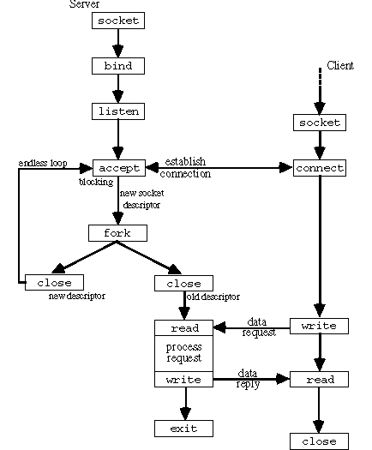
Connection Oriented Concurrent Server
TCP Client Server

Slide 21
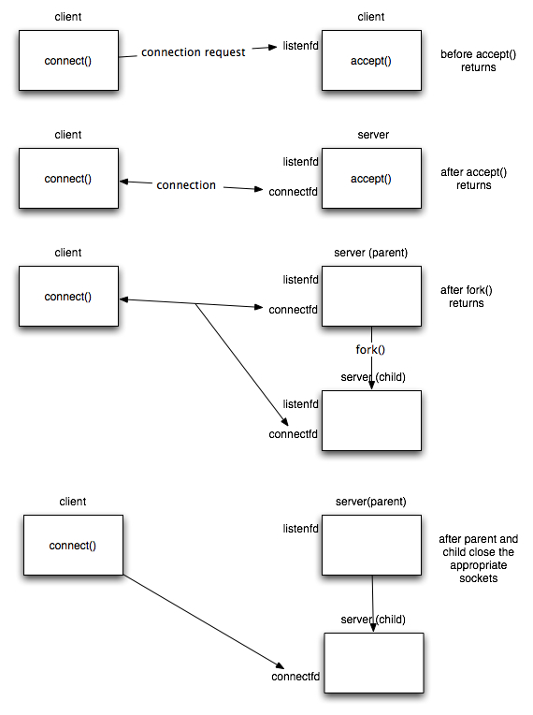
Connection Oriented Concurrent Server
server
before fork()…

Slide 22
Connection Oriented Concurrent Server
after fork()…

Slide 23
Concurrent Server with One Connection
206.62.226.35
206.62.226.66
198.69.10.2
server
connection request to
client
206.62.226.35, port 21
listening socket
(*.21, *.*)
{198.69.10.2.1500,
206.62.226.35.21}
Connection request from client to server
206.62.226.35
206.62.226.66
198.69.10.2
server
client
listening socket
(*.21, *.*)
{198.69.10.2.1500,
206.62.226.35.21}
fork
connection
server
connected
(child)
socket
{206.62.226.35.21,
198.69.10.2.1500}
Concurrent server has child handle client

Slide 24
Concurrent Server with Two Connections
206.62.226.35
206.62.226.66
198.69.10.2
server
client1
listening socket
(*.21, *.*)
{198.69.10.2.1500,
connection
206.62.226.35.21}
fork
server
client2
connected
(child1)
socket
{206.62.226.35.21,
{198.69.10.2.1501,
198.69.10.2.1500}
connection
206.62.226.35.21}
server
connected
(child2)
socket
{206.62.226.35.21,
198.69.10.2.1501}
Second client connection with same server

Slide 25
Fork System Call

Slide 26
Fork
pid_t fork (void);
Only way in Unix to create a new process
Called once and returns twice
Returns 0 in child, process ID of child in parent, -1 on error
Two main uses of fork():
  Process wants to make a copy of itself
    one copy handles one function and the other handles the other function
  Process wants to execute another program
Increments reference count of socket descriptors

Slide 27
Calling fork( )
Child can obtain parent’s process ID by calling getppid( )
All descriptors open in parent before calling fork() are shared by child after fork( ) returns
Network Servers:
  Parent calls accept( ), then calls fork( )
  Connected socket shared between parent and child
  Parent closes the connected socket
  Child reads/writes the connected socket

Slide 28
Example Code;
Concurrent Server

Slide 29
server.c: (include, define)
#include <stdio.h>
#include <stdlib.h>
#include <errno.h>
#include <string.h>
#include <sys/types.h>
#include <netinet/in.h>
#include <sys/socket.h>
#include <sys/wait.h>
#define PORT 1233 /* my well-known port */
#define BACKLOG 10 /* length of pending connections queue */

Slide 30
server.c: (main, socket)
int main(void)
{
int sockfd, new_fd; /* listen on sockfd */ /* new connection on new_fd */
struct sockaddr_in my_addr; /* server address */
struct sockaddr_in their_addr; /* client addr */
int sin_size; /* address size */
if ((sockfd = socket(AF_INET, SOCK_STREAM, 0)) == -1) {
perror("socket");
exit(1);
}

Slide 31
server.c: (bind)
my_addr.sin_family = AF_INET; /* host byte order */
my_addr.sin_port = htons(MYPORT); /* convert to short, network byte order */
my_addr.sin_addr.s_addr = (INADDR_ANY); /* automatically fill with my IP */
bzero(&(my_addr.sin_zero), 8); /* zero the rest of the struct */
if (bind(sockfd, (struct sockaddr *)&my_addr, sizeof(struct sockaddr)) == -1) {
perror("bind");
exit(1);
}

Slide 32
server.c: (listen, accept)
if (listen(sockfd, BACKLOG) == -1) {
perror ("listen"); exit (1);
}
while(1) { /* main accept() loop ; always true*/
sin_size = sizeof (struct sockaddr_in);
if ((new_fd = accept (sockfd, (struct sockaddr*) &their_addr, &sin_size)) == -1) {
perror ("accept"); continue;
}
printf("server: got connection from %s\n", inet_ntoa (their_addr.sin_addr));

Slide 33
server.c: (fork, send, close)
if (!fork()) { /* this is the child process */
close (sock_fd); /* child doesn't need it */
if (send (new_fd, "Hello, world!\n", 14, 0) == -1)
perror ("send");
close (new_fd); exit(0);
}
close (new_fd); /* parent doesn't need this */
} /* outer while loop ends here */
} /* main function ends here */

